Slide 1
Math 141z Lesson 8: Assembling Functions

Slide 2
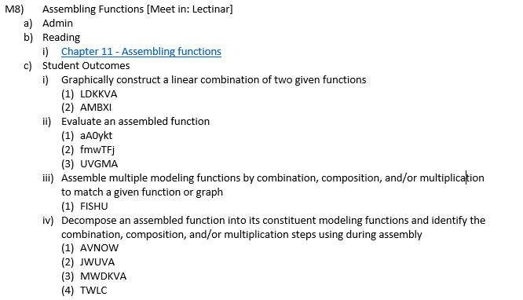
Objectives: Lesson 8

Slide 3
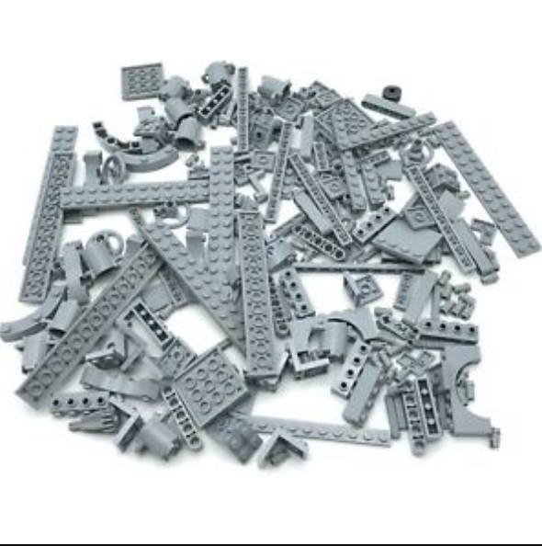
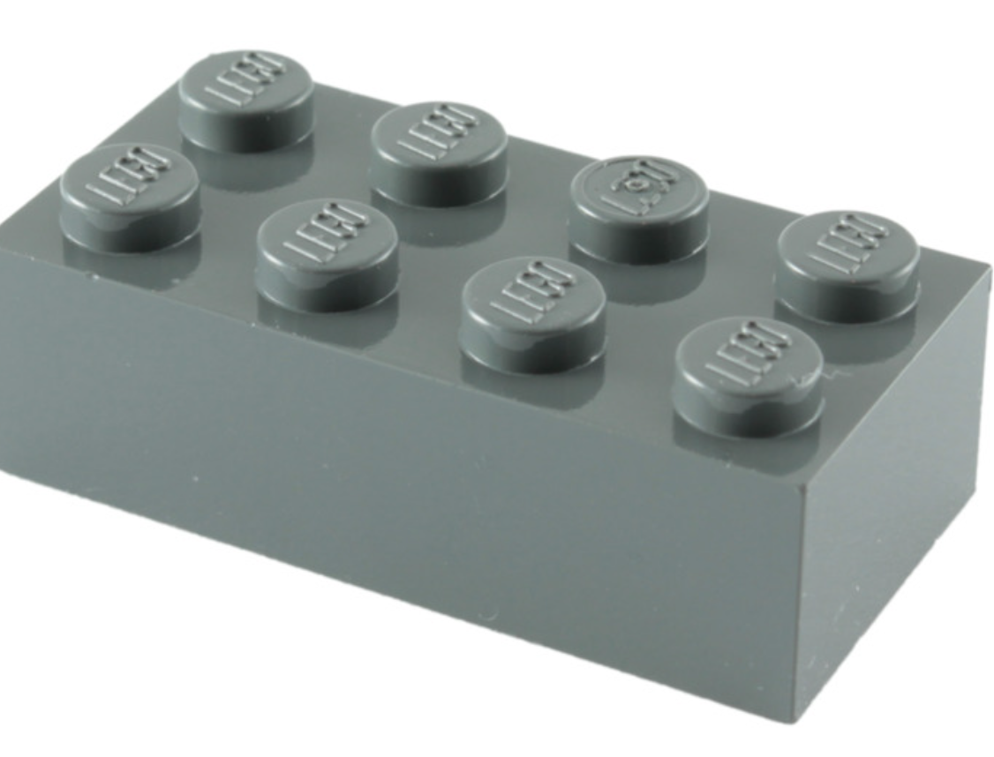
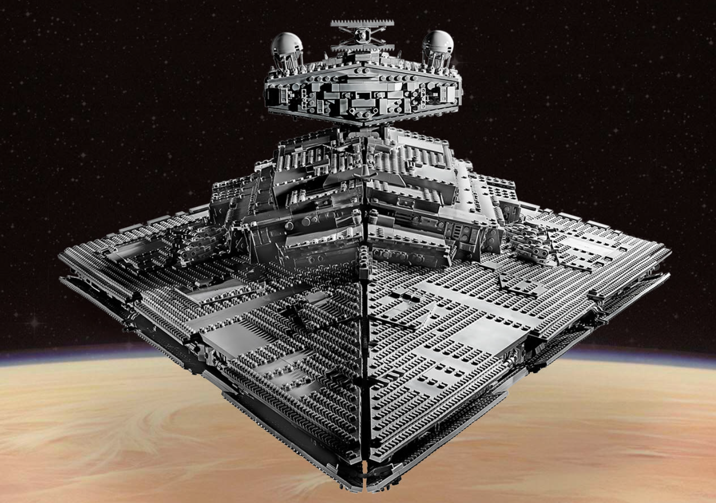
Big Picture: Functions let us build a star destroyer
Pattern Book Functions with parameters
Slope functions
Inverse functions
Compositions & combinations of functions
Pattern Book Functions without parameters
Documentation statement: Col Finkelstein made this slide for Lesson 07 and I copied it word for word. I should not get any credit for this work.

Slide 4
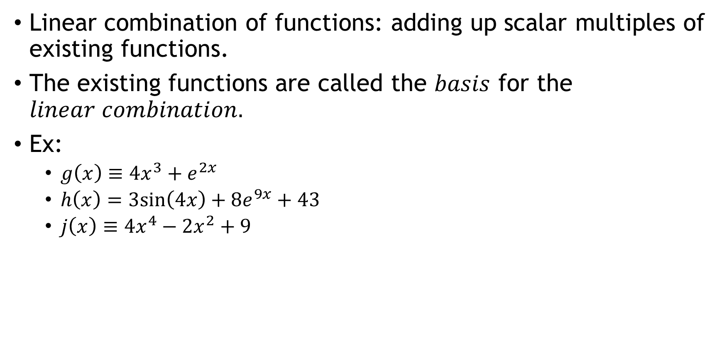
Linear Combinations
Linear combination of functions: adding up scalar multiples of existing functions.
The existing functions are called the $basis$ for the $linear combination.$
Ex:
$g\left(x\right)≡4x^{3}+e^{2x}$
$h\left(x\right)=3sin\left(4x\right)+8e^{9x}+43$
$j\left(x\right)≡4x^{4}−2x^{2}+9$

Slide 5
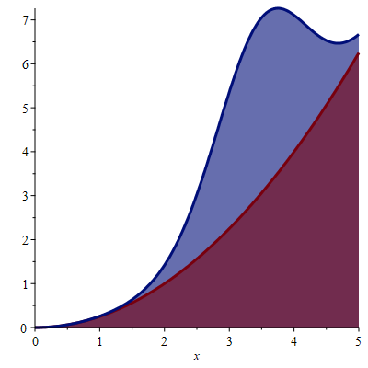
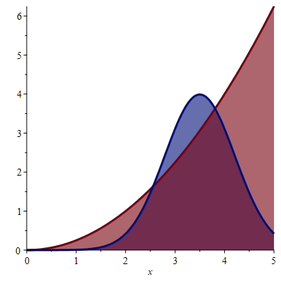
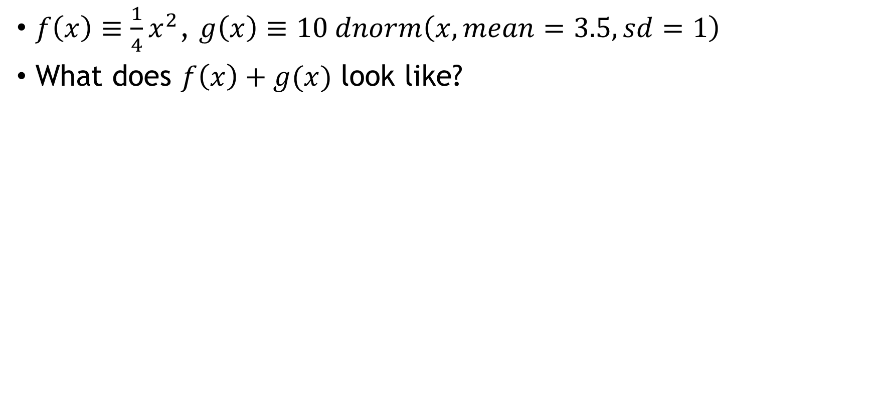
What does this look like?
$f\left(x\right)≡\frac{1}{4}x^{2}$, $g\left(x\right)≡10 dnorm\left(x,mean=3.5, sd=1\right)$
What does $f\left(x\right)+g(x)$ look like?
Add

Slide 6
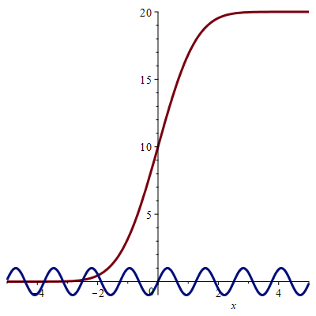
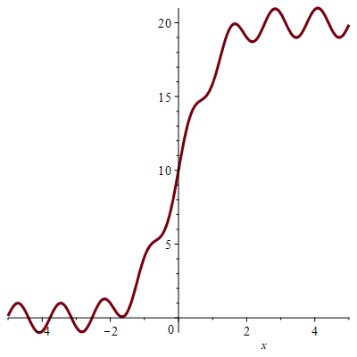
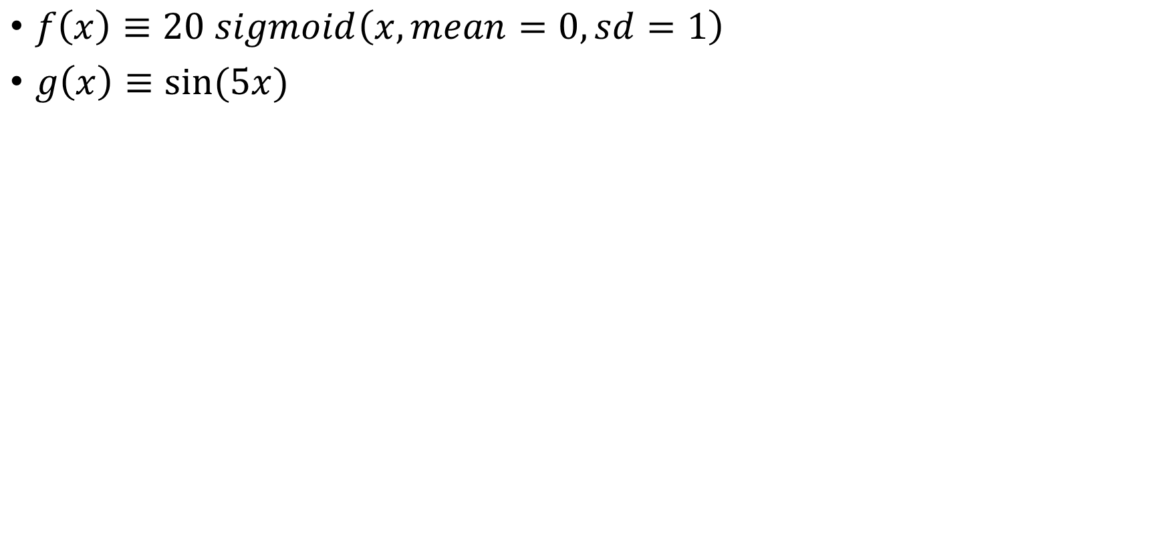
More Linear Combinations
$f\left(x\right)≡20 sigmoid\left(x,mean=0,sd=1\right)$
$g\left(x\right)≡sin⁡(5x)$
Add

Slide 7
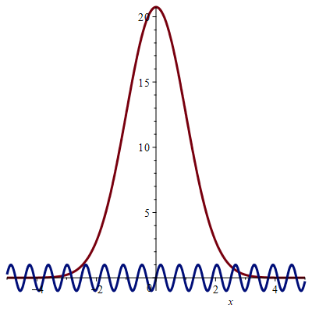
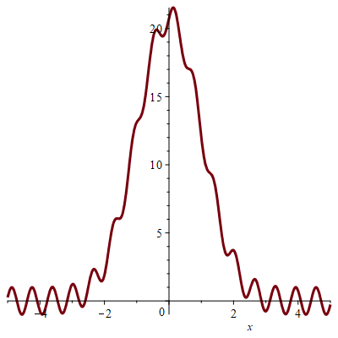
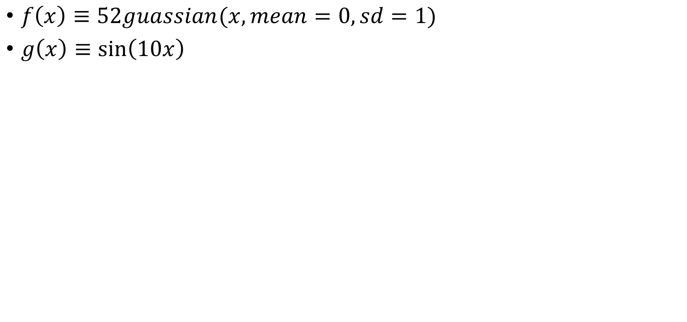
More Linear Combinations
$f\left(x\right)≡52guassian(x,mean=0,sd=1)$
$g\left(x\right)≡\sin\left(10x\right)$
Add

Slide 8
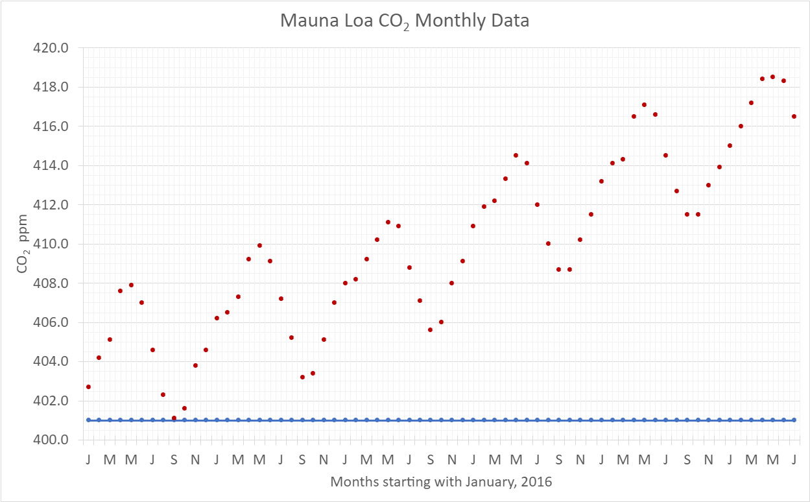
Linear Combinations

Slide 9
Linear Combinations

Slide 10
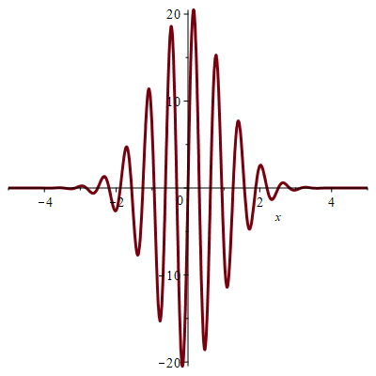
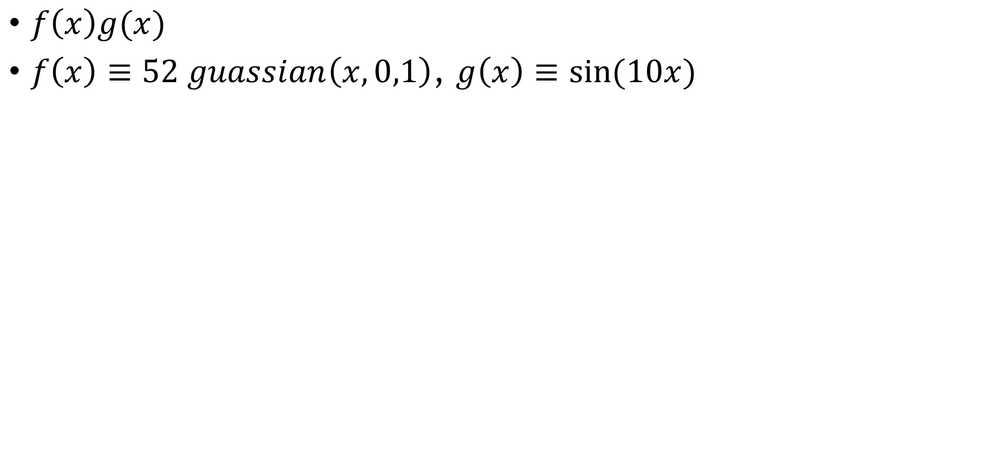
Products of Functions
$f\left(x\right)g(x)$
$f\left(x\right)≡52 guassian\left(x,0,1\right)$, $g\left(x\right)≡sin⁡(10x)$
Product

Slide 11
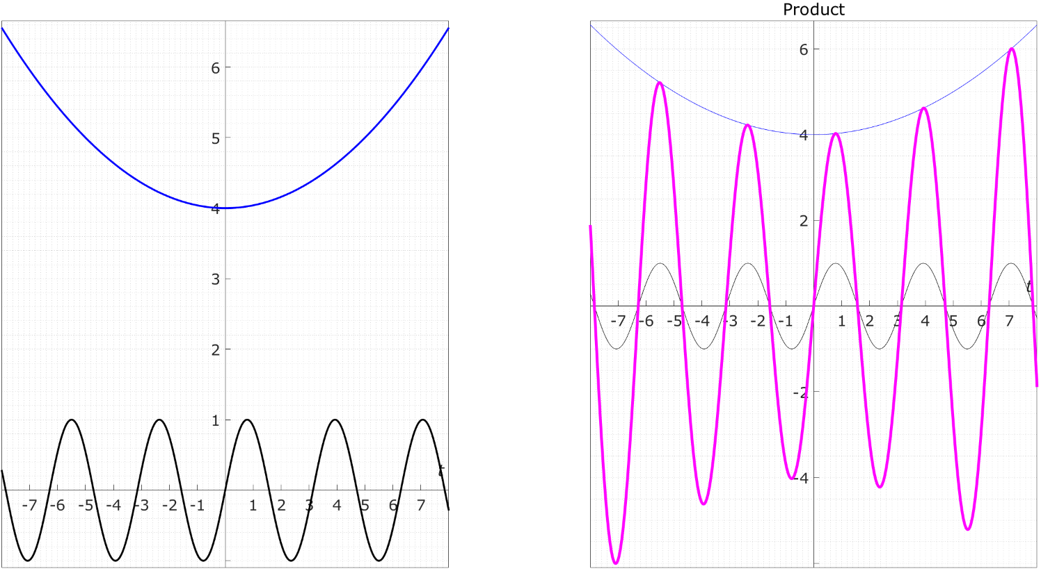
Sums and Products of Functions

Slide 12
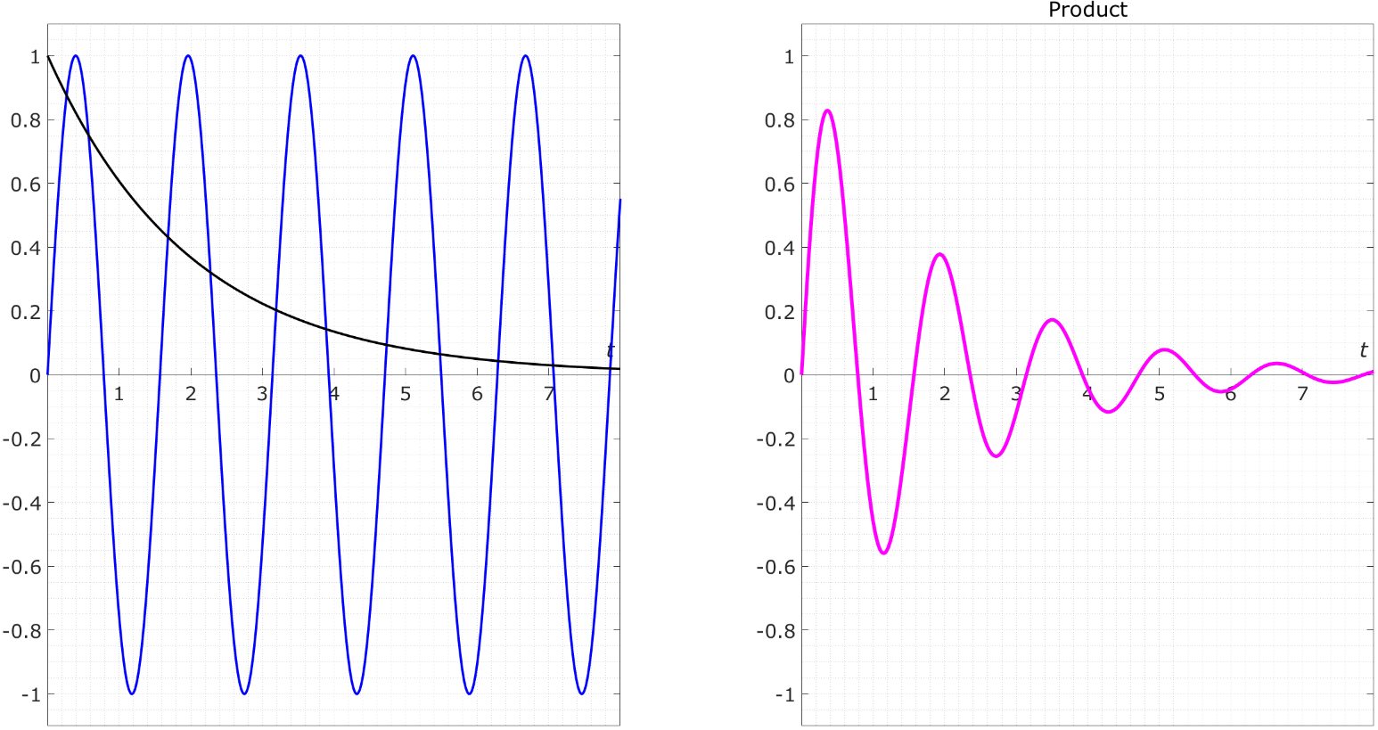
Sums and Products of Functions

Slide 13
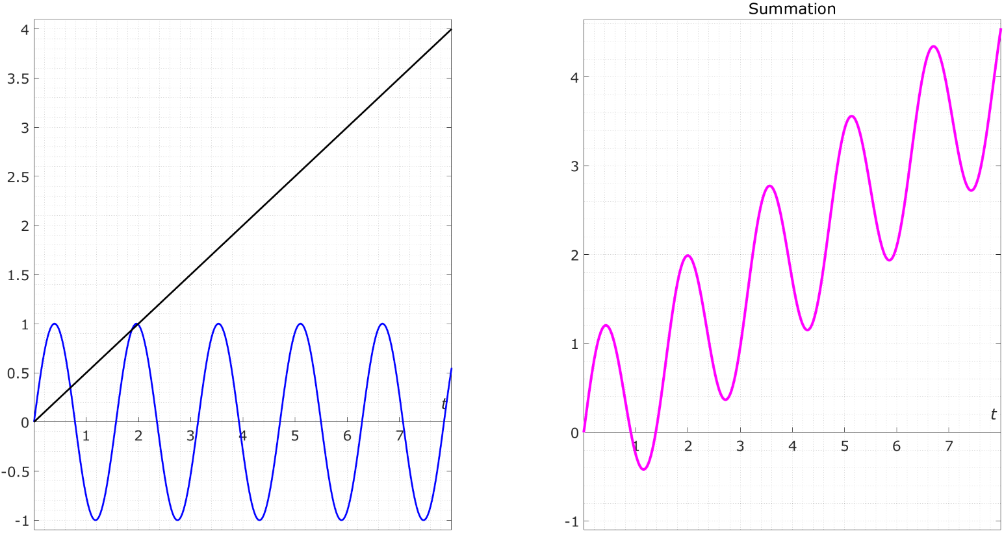
Sums and Products of Functions

Slide 14
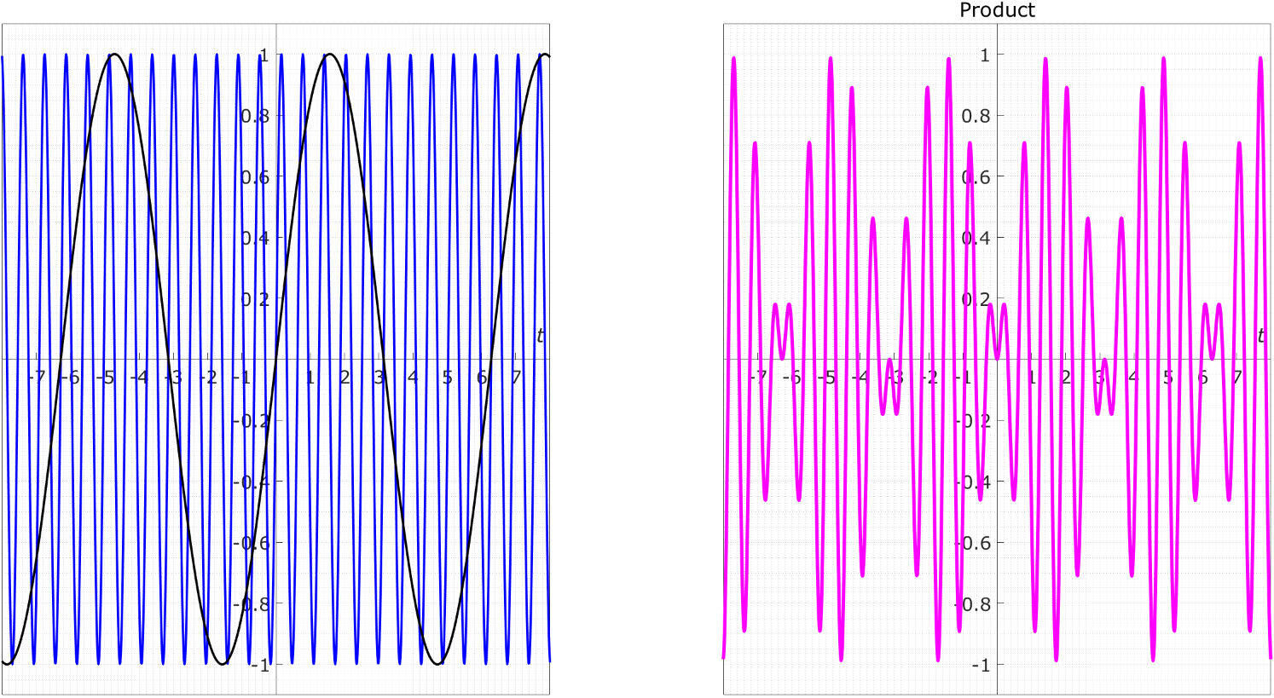
Sums and Products of Functions

Slide 15
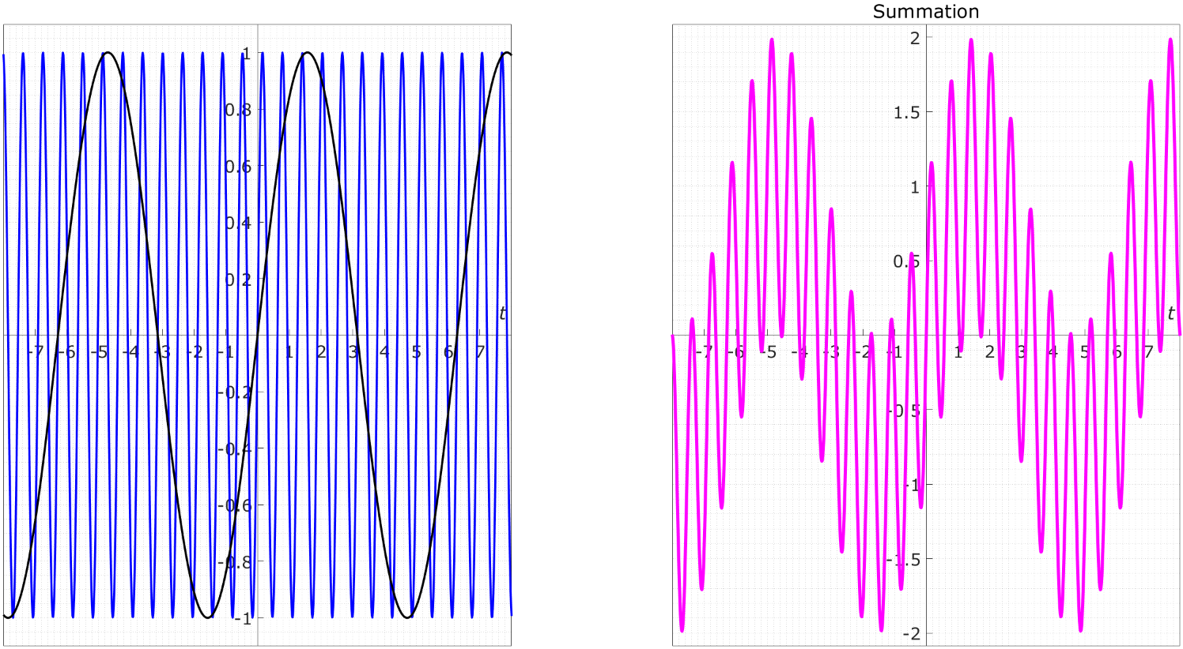
Sums and Products of Functions

Slide 16
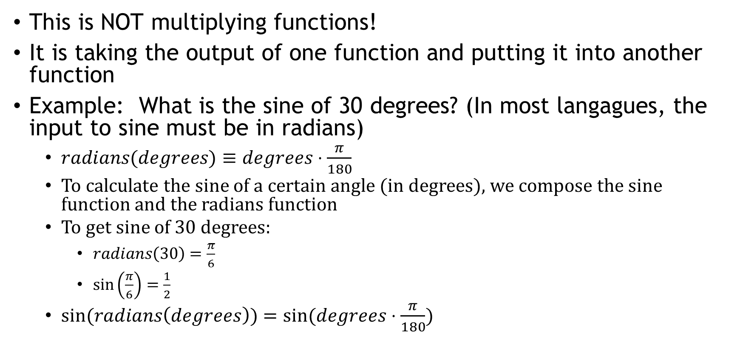
Composition of functions
This is NOT multiplying functions!
It is taking the output of one function and putting it into another function
Example: What is the sine of 30 degrees? (In most langagues, the input to sine must be in radians)
$radians(degrees)≡degrees⋅\frac{π}{180}$
To calculate the sine of a certain angle (in degrees), we compose the sine function and the radians function
To get sine of 30 degrees:
$radians\left(30\right)=\frac{π}{6}$
$sin\left(\frac{π}{6}\right)=\frac{1}{2}$
$sin⁡(radians\left(degrees\right))=sin⁡(degrees⋅\frac{π}{180})$

Slide 17
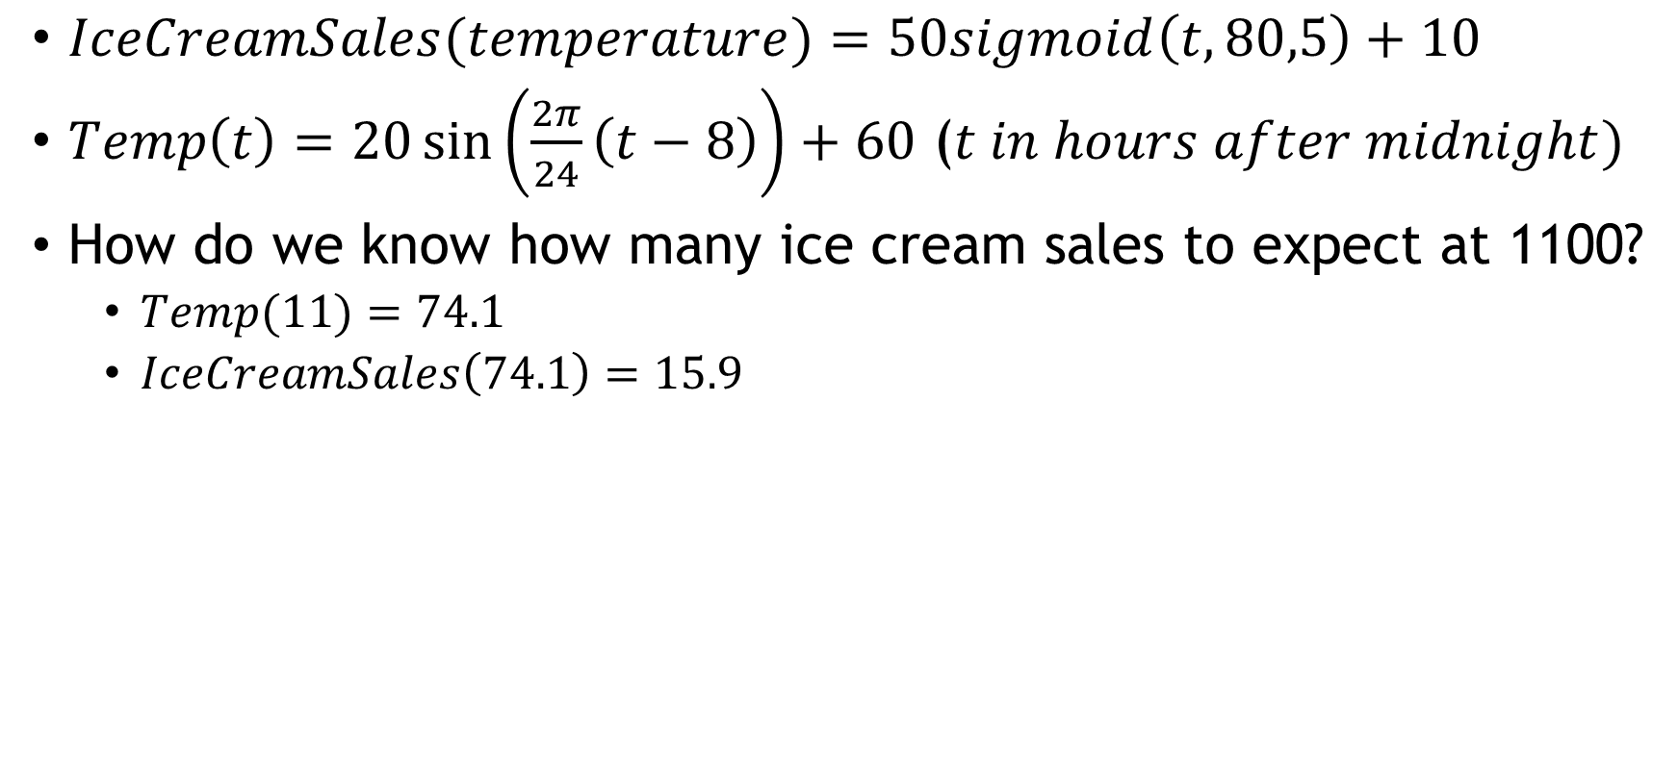
Composition of Functions
$IceCreamSales(temperature)=50sigmoid\left(t,80,5\right)+10$
$Temp\left(t\right)=20\sin\left(\frac{2π}{24}\left(t−8\right)\right)+60$ ($t in hours after midnight)$
How do we know how many ice cream sales to expect at 1100?
$Temp(11)=74.1$
$IceCreamSales\left(74.1\right)=15.9$

Slide 18
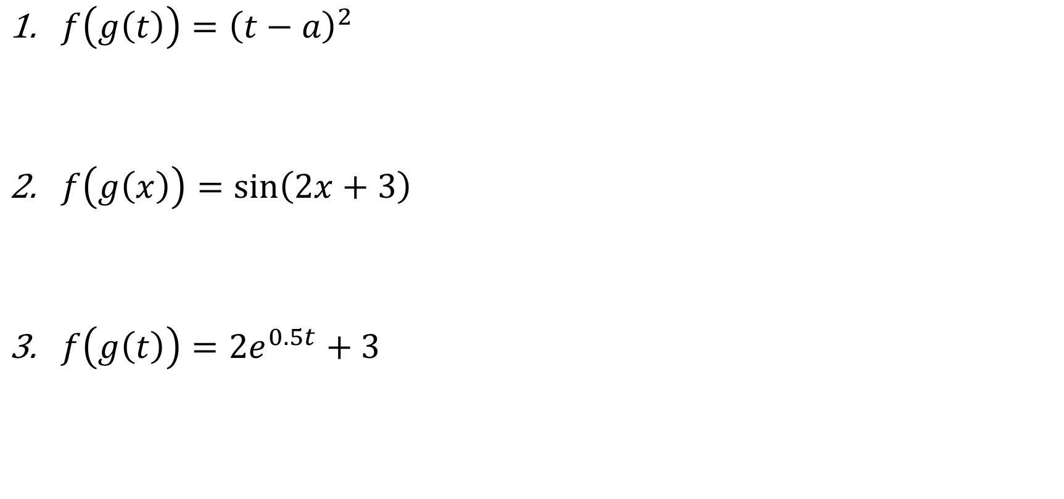
Decompose these functions
$f\left(g\left(t\right)\right)={\left(t−a\right)}^{2}$
$f\left(g\left(x\right)\right)=\sin\left(2x+3\right)$
$f\left(g\left(t\right)\right)=2e^{0.5t}+3$

Slide 19
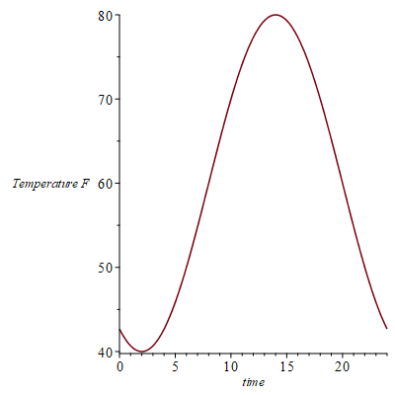
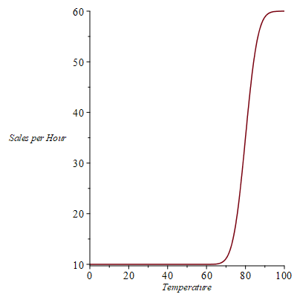
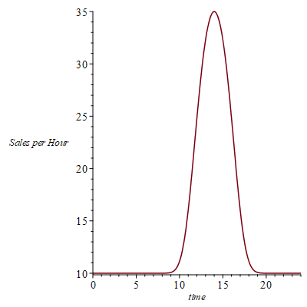
Composition of Functions

Slide 20
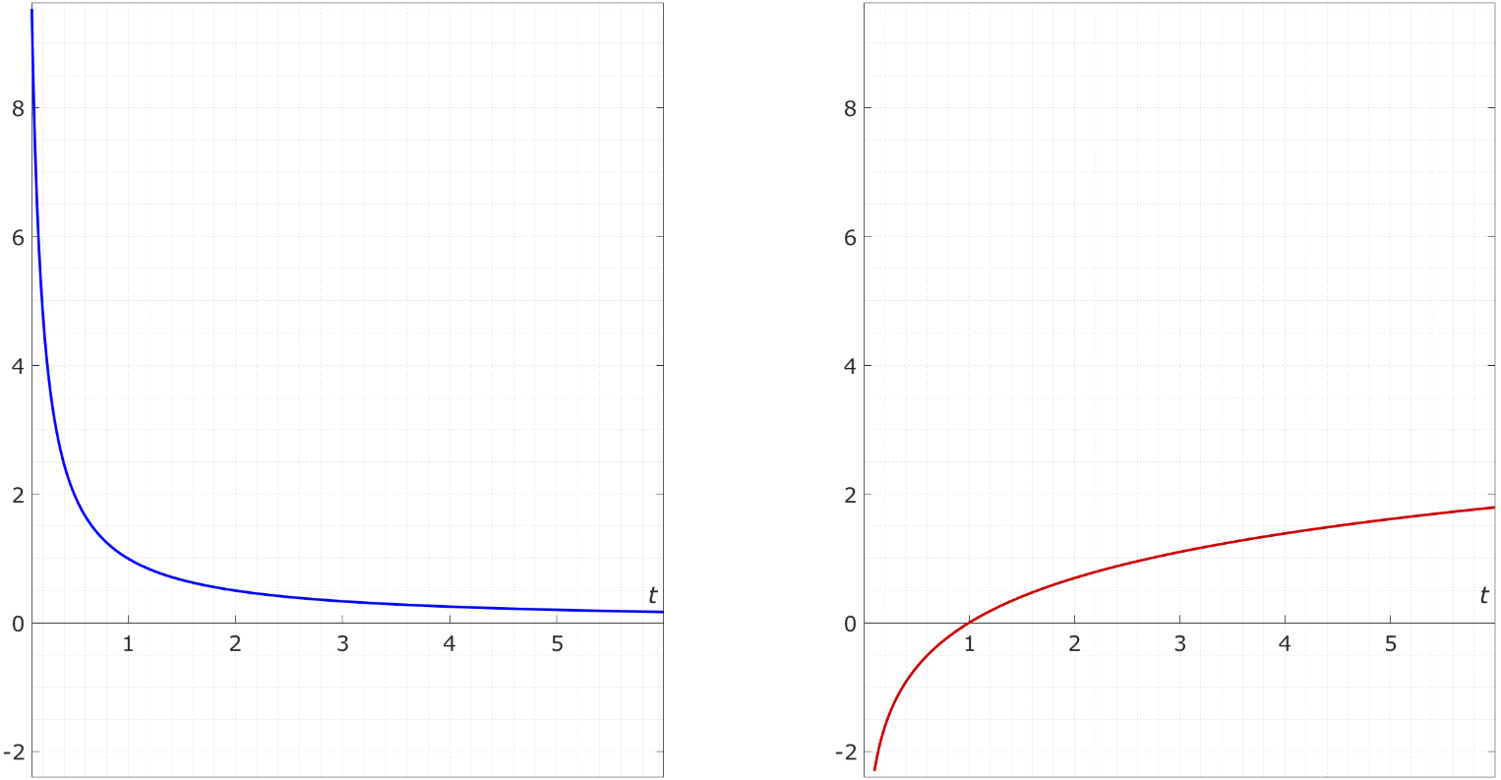
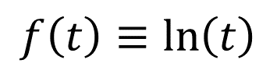
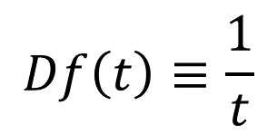
Function and It’s Derivative (it’s slope function)
$$Df\left(t\right)≡\frac{1}{t}$$
$$f\left(t\right)≡\ln\left(t\right)$$

Slide 21
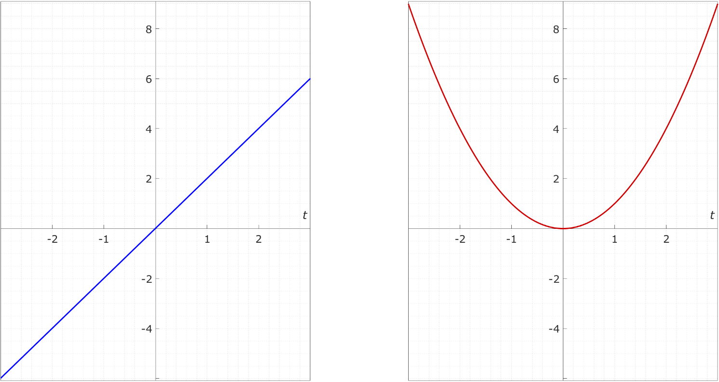
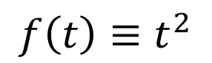
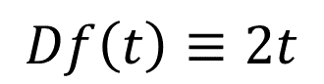
Function and It’s Derivative (it’s slope function)
$$Df\left(t\right)≡2t$$
$$f\left(t\right)≡t^{2}$$

Slide 22
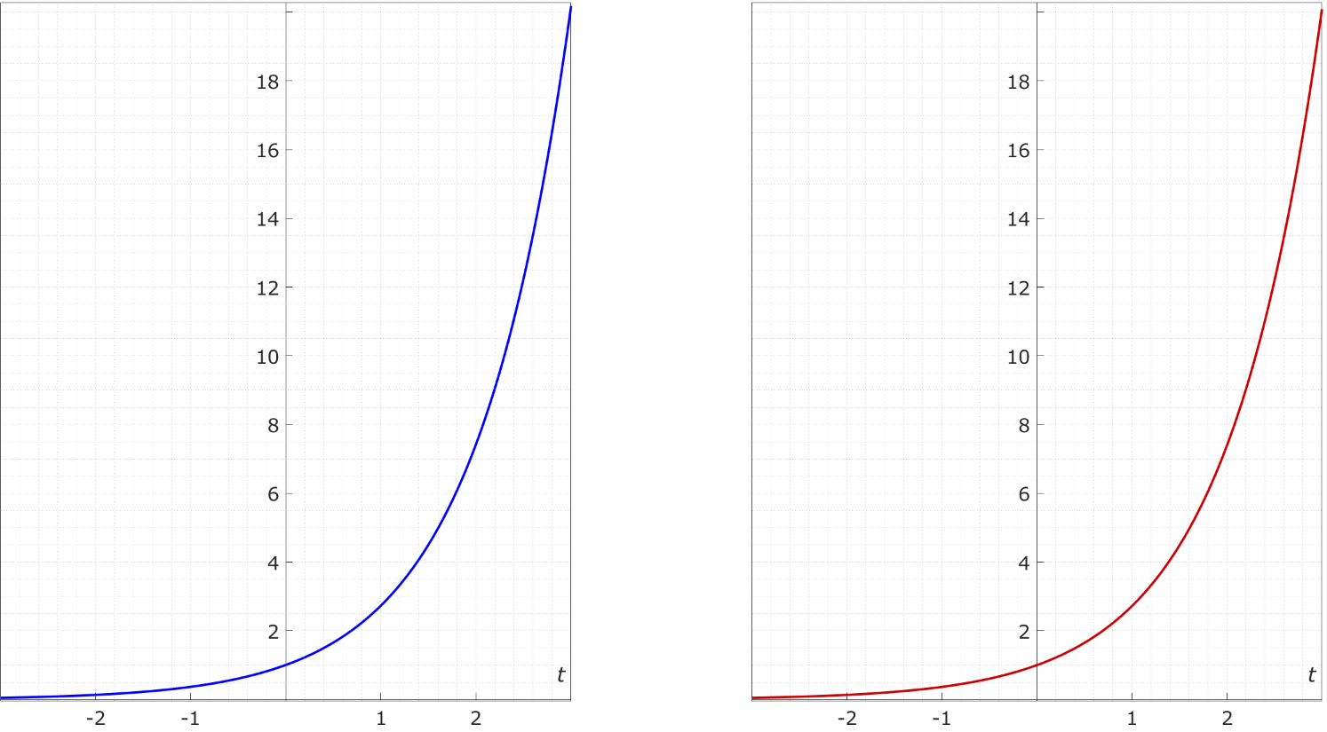
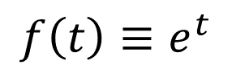
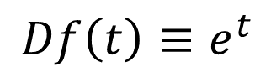
Function and It’s Derivative (it’s slope function)
$$Df\left(t\right)≡e^{t}$$
$$f\left(t\right)≡e^{t}$$

Slide 23
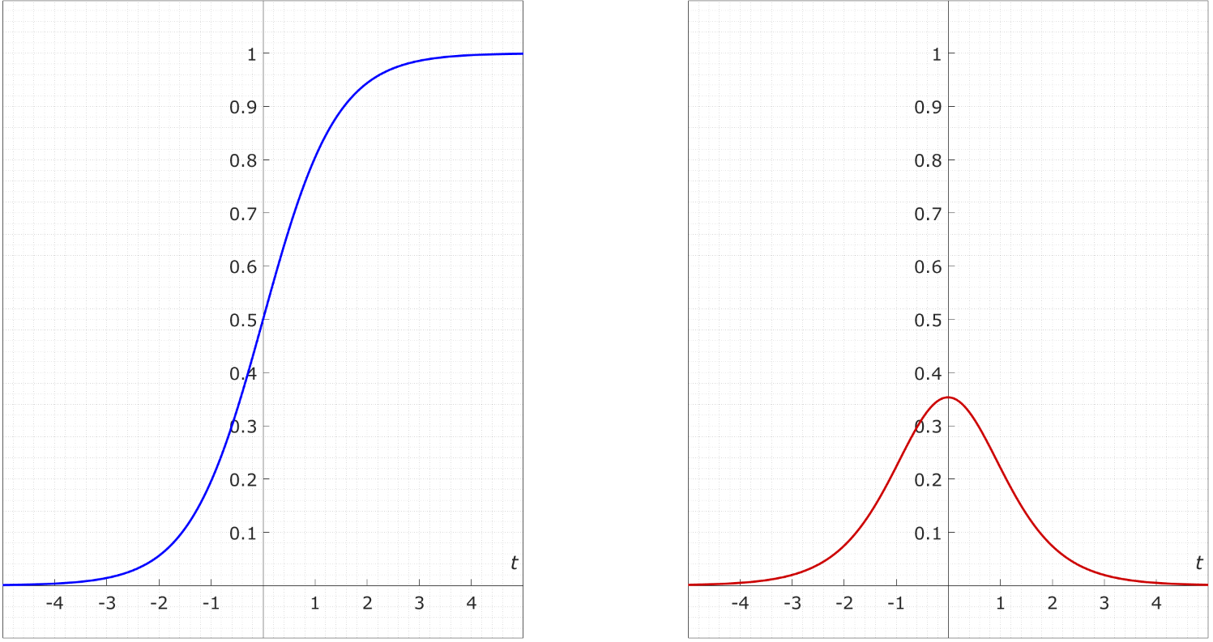
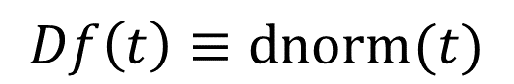
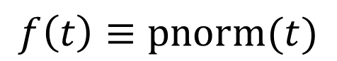
Function and It’s Derivative (it’s slope function)
$$f\left(t\right)≡pnorm(t)$$
$$Df\left(t\right)≡dnorm(t)$$

Slide 24
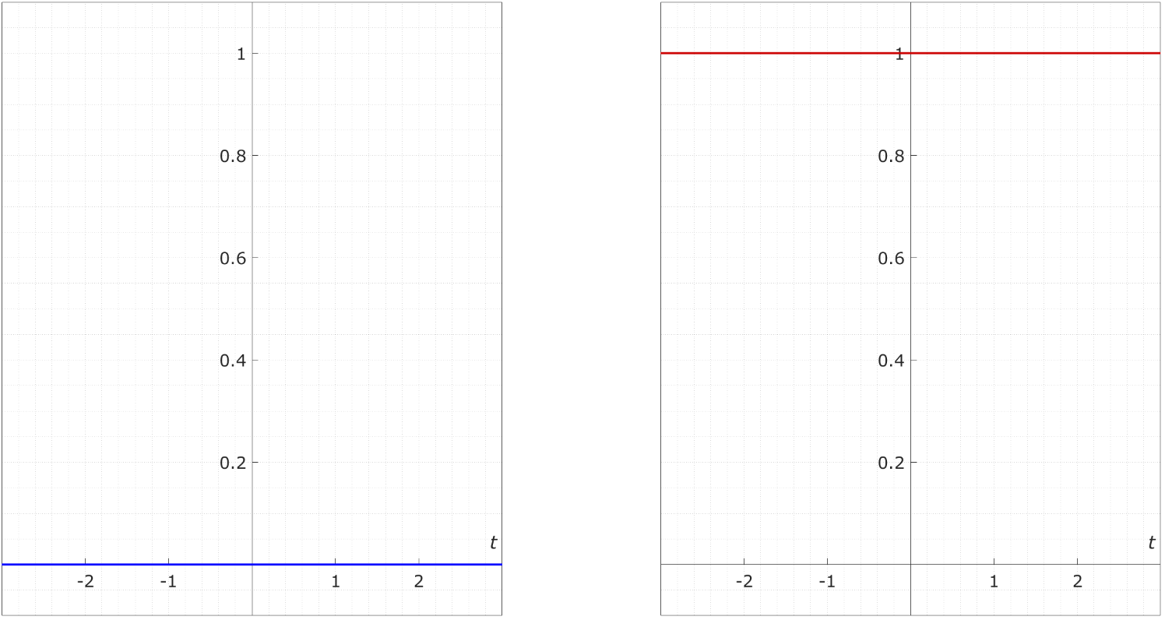
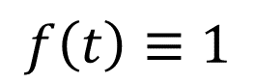
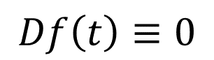
Function and It’s Derivative (it’s slope function)
$$Df\left(t\right)≡0$$
$$f\left(t\right)≡1$$

Slide 25
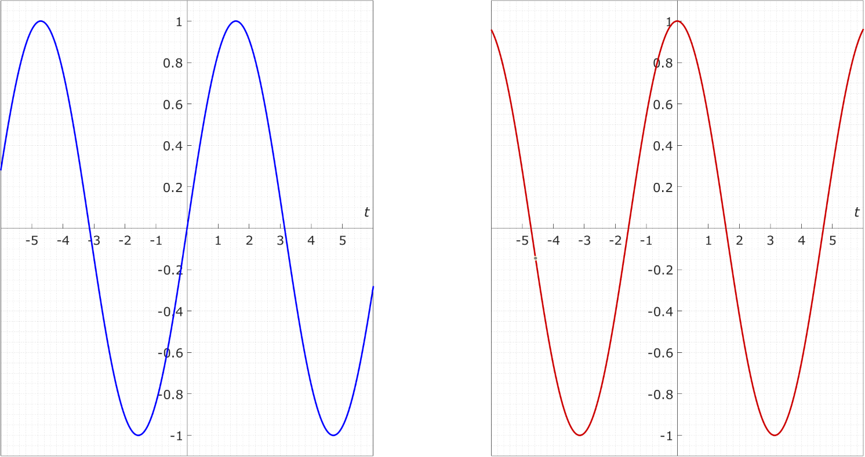
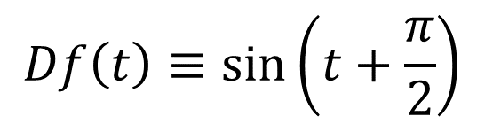
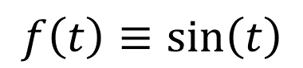
Function and It’s Derivative (it’s slope function)
$$Df\left(t\right)≡\sin\left(t+\frac{π}{2}\right)$$
$$f\left(t\right)≡\sin\left(t\right)$$

Slide 26
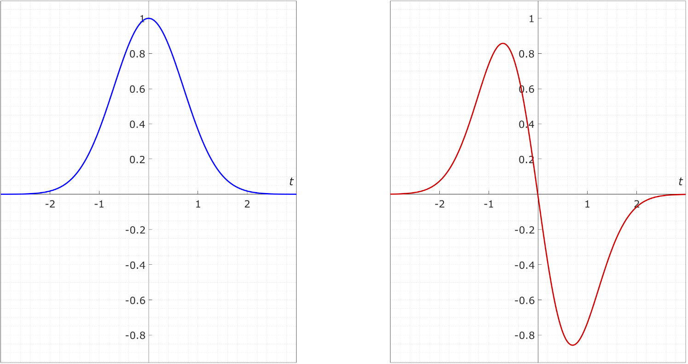
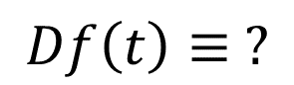
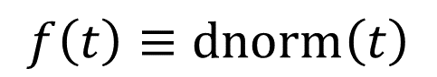
Function and It’s Derivative (it’s slope function)
$$Df\left(t\right)≡ ?$$
$$f\left(t\right)≡dnorm\left(t\right)$$

